Slide 1
Cyborg Reading Reading at Scale

Slide 2
Computers
What are computers good at?

Slide 3
Computers
What are computers good at?
Math
Repetitive tasks
Storing large amounts of information

Slide 4
Computers
What are some jobs that computers might be good at?

Slide 5
Computers
What are some jobs that computers might be good at?
Keeping track of your grades
Storing emails

Slide 6
Humans
Good at thinking!
Good at inferring
But we’re slow

Slide 7
Cyborg Reading
Bridging the gap between computers /humans
Natural Language Processing: attempts to translate between human and computer languages.
Natural languages: Chinese, French, English
Computer language (Ruby):
5.times do
print “hello”
end
Notes:
What do you think this program here does?

Slide 8
How Computers Read
“It would have been clear to anyone, who looked at Sweeney Todd as he took his route from his own shop in Fleet-street to Bell-yard, Temple Bar, that it was not to eat pies he went there.”
that’s one big long chunk of text. A string.
There are certain things you can only do to text:
Capitalize, lowercase, divide into words.
Notes:
Believe it’s useful for you to know a little bit about what’s happening behind the scenes.
Explain data types – one type is a string

Slide 9
How Computers Read
Compare with:
4
12
15
You can’t capitalize these. They’re not strings.
They’re integers, and you can do math things to them:
Add, subtract, multiply, etc.

Slide 10
How Computers Read
So much of what we’re doing is translating between data types for the computer – turning texts/strings into things that can be counted.

Slide 11
Tokenization
“It would have been clear to anyone, who looked at Sweeney Todd as he took his route from his own shop in Fleet-street to Bell-yard, Temple Bar, that it was not to eat pies he went there.”
Break this into tokens by getting rid of spaces. How many are there?
Notes:
Token – the non-space chunks of a text. Useful to see how the computer breaks apart texts. Right it down.

Slide 12
Tokenization
['It', 'would', 'have', 'been', 'clear', 'to', 'anyone', ',', 'who', 'looked', 'at', 'Sweeney', 'Todd', 'as', 'he', 'took', 'his', 'route', 'from', 'his', 'own', 'shop', 'in', 'Fleet-street', 'to', 'Bell-yard', ',', 'Temple', 'Bar', ',', 'that', 'it', 'was', 'not', 'to', 'eat', 'pies', 'he', 'went', 'there', '.']
41
Did you count punctuation? Did you collapse It and it?
Notes:
What numbers did you have? Did you count punctuation? Collapse it/it? Other issues?
Be sure to tell them that the punctuation is still there at this point.

Slide 13
Segmentation
Tokenization: dividing a text into words.
Segmentation: dividing a text into sentences.
Segmentation often happens first.
Notes:
Some more definitions. We have to break large pieces into smaller.

Slide 14
Preprocessing
Remember, computers can’t infer:
“It” ≠ “it”
Different words entirely
Normalizing the data takes care of those inconsistencies
Removing stopwords is a related procedure
Both are a part of preprocessing
Notes:
More definitions.
We have to normalize things as much as possible when preparing a text for the computer – capitalization, stopwords, do you care about punctuation?

Slide 15
Preprocessing
“It would have been clear to anyone, who looked at Sweeney Todd as he took his route from his own shop in Fleet-street to Bell-yard, Temple Bar, that it was not to eat pies he went there.”
Normalize the text by removing stopwords, punctuation. Lowercase the words.
What do you get?
Notes:
Note: they will have to decide what stopwords are for them. Might have to go back for them.

Slide 16
Preprocessing
['would', 'clear', 'anyone', 'looked', 'sweeney', 'todd', 'took', 'route', 'shop', 'fleet-street', 'bell-yard', 'temple', 'bar', 'eat', 'pies', 'went']
Note that the stopwords you remove might be different.
Notes:
What stopwords did you take out? Leave in? Why?

Slide 17
Tokens and Types
Tokens: just a list of all the non-space items in a text.
Types: that same list but with repeats removed.
“A galaxy far, far away.”
Tokens: ['a', 'galaxy', 'far’, ‘,’, 'far', 'away']
Types: ['far’, 'a', ‘,’, 'away', 'galaxy’]
‘far’ gets collapsed.
A given text could have 1,000,000 tokens and only 5000 types.
Notes:
Sometimes we might care about the repetition sometimes we might not.
Tokens vs types.
Write an example sentence on the board – “Woof woof woof’ says the dog. I say hello.’ How many tokens and types?

Slide 18
All the tools we’re using are converting text to math
Different way of reading
Veers into the realm of statistics
What can numbers tell us about complicated humanities questions?
Emotion
Theme
Notes:
Prism – converting things to math
Google ngrams – converting to math.
Basic building blocks
We’ll get into more complicated bits as time goes on.
But always – we’re trying to determine how you can measure things and convert complicated categories into things that can be quantified.

Slide 19
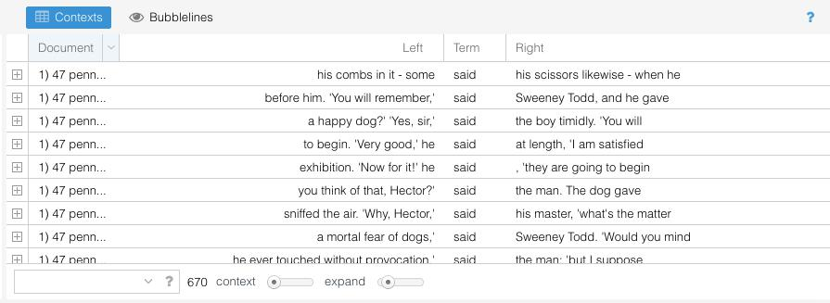
Voyant pt 2
goo.gl/c00x6s
Notes:
Open up voyant again – load in the text
KWIC this contexts view at the bottom – what is this showing you? Probably bot right by default
Concordance view that changes depending on the words. This can help you to learn new things. Move between distant and close reading
Context slider – changes how many words you see on either side. Expand has to do with how many words you’ll see when you double click on the box.
Here we can get a little more information about said – the most common non-stopword in the text.
What are some questions you might want to ask about the word said? How many of them depend on particular words?

Slide 20
N-grams
N-gram – sequence of words of length n
“My name is Brandon.”
Bigrams – “my name”, “name is”, “is Brandon”
Trigrams – “my name is”, “name is Brandon”
Longer than that and they just become “n-gram of length X”
Notes:
Certain phrase lengths have special names

Slide 21
n-grams
“Moreover Sweeney Todd, in common with his brethren in those really primitive sorts of times, did not think it at all necessary to have any waxen effigies of humanity in his window.”
What are some bigrams? Some trigrams?

Slide 22
n-grams cont.
waxen effigies
Sweeney Todd
all necessary
Are these the same kind of bigrams? Any distinctions?
Notes:
How is sweeney todd different from another phrase you might see?

Slide 23
n-grams vs. collocation
waxen effigies - bigram
Sweeney Todd - collocation AND bigram
all necessary - bigram
Collocation – a recognizable, common sequence. Have special meaning together.
Notes:
What are some other collocations that are also bigrams? Examples?

Slide 24
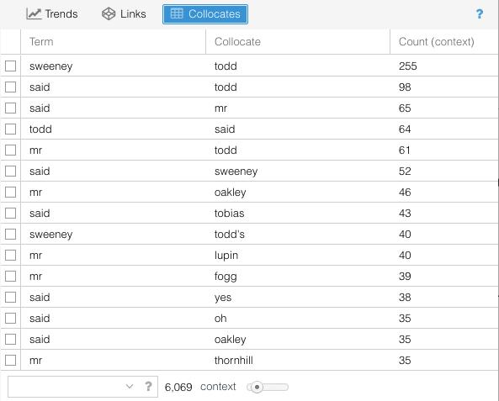
Notes:
Voyant gives you access to all the collocations in the text. You can see what bigrams tend to occur in statistically significant numbers. To access this panel you might need to hover over the question mark, click the add panes bit, look under grid tools, and add collocations. These are the most statistically prevalent phrases. What do you see.

Slide 25
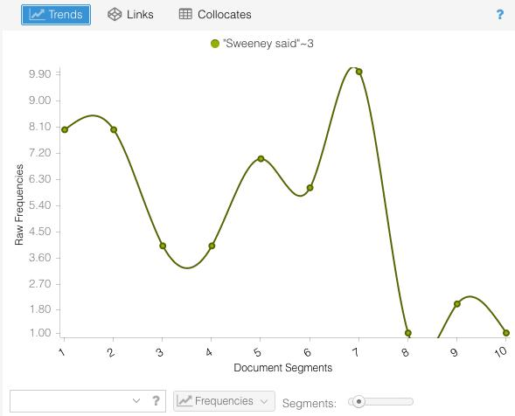
Notes:
Notice how clicking on a collocate will modify the trends pane so that it is now tracked.

Slide 26
Exercise
Find two collocates that illuminates the text for you in some way.
Compare them on the trends pane.
What did you find?

Slide 27
Exercise
Do you already have materials for your final projects ready to go? If so, play with it in Voyant.
If not, gather materials for it. We’re here to answer questions.
Or, play with the corpus here: goo.gl/E8T2r9

